Slide 1
Management of Vegetable Diseases in Georgia
BHABESH DUTTA
ASSISTANT PROFESSOR AND VEGETABLE EXTENSION PATHOLOGIST
COASTAL PLAIN EXPERIMENT STATION
UNIVERSITY OF GEORGIA, TIFTON

Slide 2
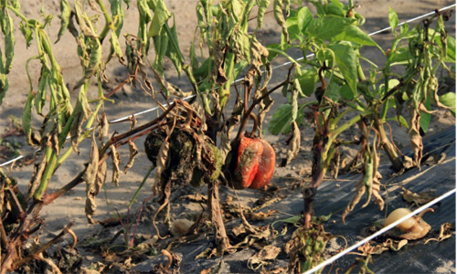
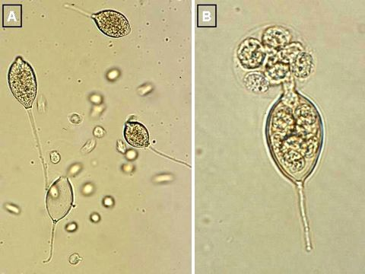
Phytophthora capsici (P. capsici) seedling and fruit blight
Phytopthora capsici is a water mold
Cucurbits and peppers are the most susceptible hosts
Not a true fungus but fungus like
Pathogen is soil and water borne
Infection starts from low lying wet areas in the field
Sporangia

Slide 3
P. capsici trial in pepper (Dr. Pingsheng Ji)
Orondis used as drench or foliar along with Presidio/Revus rotation was effective against P. capsici

Slide 4
P. capsici (fungicide spray guide)
Orondis+ Ridomil Gold (applied as pre-plant or through drip)
Rotate with Presidio and Revus
Drip application: 2 applications of Orondis Gold in a 30 day interval after first application at planting.

Slide 5
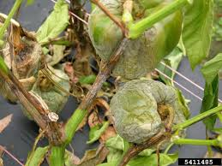
Management of P. capsici in pepper
Rotate with non-host crop
Avoid poorly drained fields
Fumigation not very effective
Resistant varieties
Fungicides Orondis, Presidio,
Revus

Slide 6
P. capsici trial in pepper (Dr. Pingsheng Ji)
V10208 used as drench or drip or foliar in rotation with Presidio effectively managed P. capsici

Slide 7
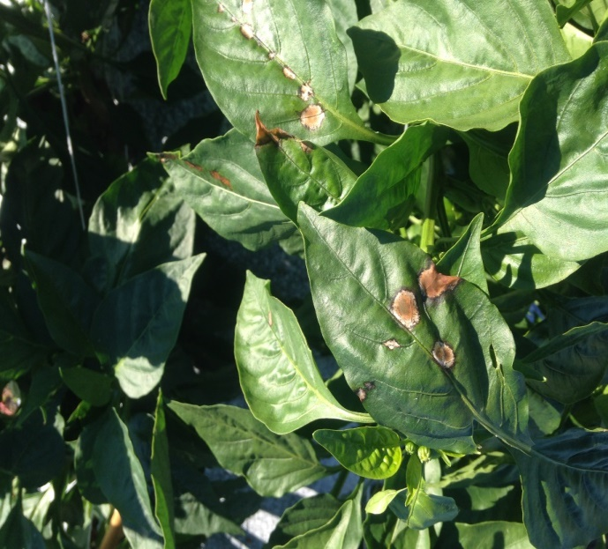
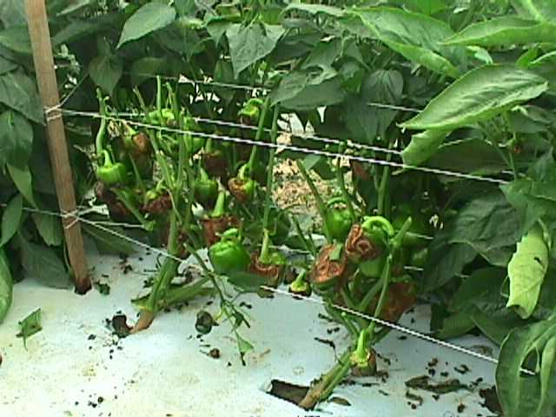
Anthracnose in pepper
Only shows up on fruit
Colletotrichum acutatum hits fruit at all stages
Strobilurins work well (Cabrio, Quadris, Generics)

Slide 8
Field trial on pepper anthracnose (UGA)

Slide 9
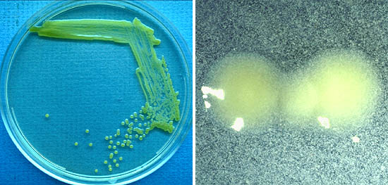
Bacterial Leaf Spot (BLS) of Pepper
Causal organism: Xanthomonas euvesicatoria
Most economically important disease in pepper in GA
Chemical management: Multiple sprays of copper+mancozeb recommended
Copper tolerant strains and weather conditions affect efficacy
http://www.apsnet.org/edcenter/intropp/lessons/prokaryotes/Pages/Bacterialspot.aspx
Notes:
Bacterial leaf spot is caused by a Gram negative bacterium Xanthomonas euvesicatoria. It is most important disease in pepper in GA. Every year, we observe BS outbreak. One of the management options, copper mancozeb sparys over the growing season is recommended; however, control of disease has been variable mainly because of the presence of copper tolerant strains in nature and weather conditions that affect efficacy of copper.

Slide 10
Integrated Disease Management of BLS in pepper
Use clean seed!
Use resistant varieties as available (X10R varieties in bell pepper)
Don’t work wet fields! Drip irrigate!
Don’t overuse nitrogen!
Rotate away from fields with history of disease in same year
Apply plant protection products preventively
Actigard (use early to induce plant defense)
Copper+Mancozeb spray
Don’t rely on one or two methods or chemicals!

Slide 11
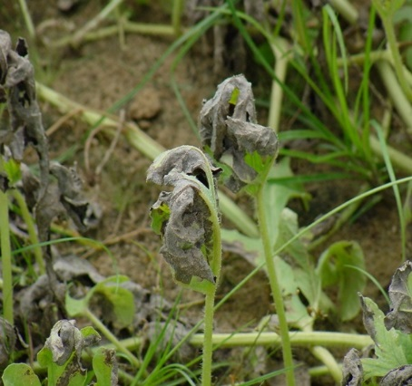
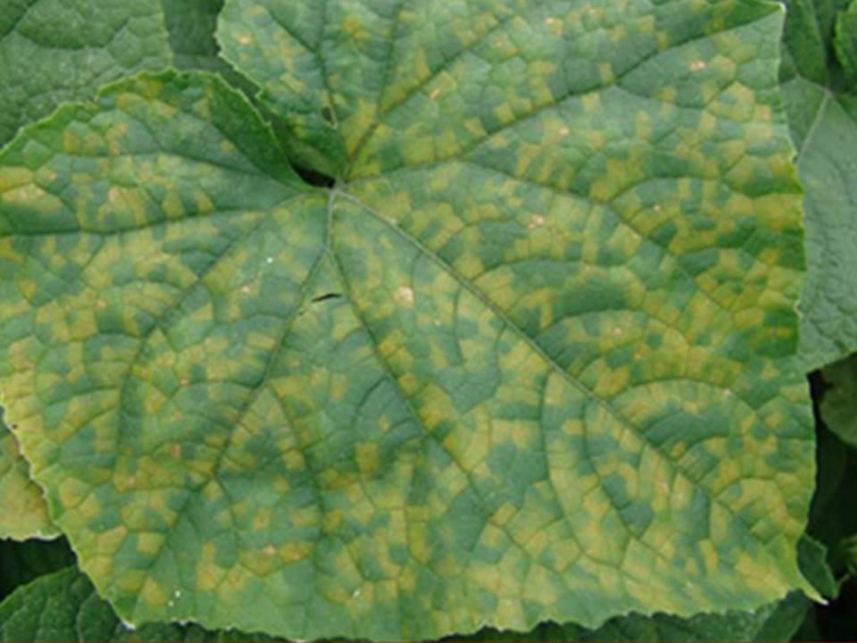
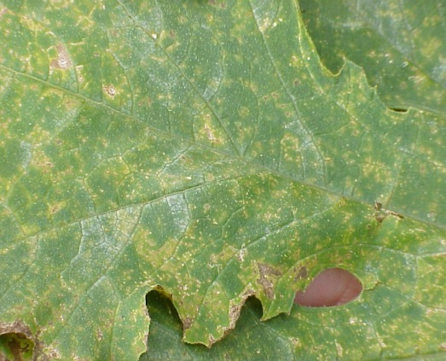
Downy mildew of cucurbit
Mid-Late Season
Overwinters in South Florida
Moves into GA (May-June)
CDM IPMPIPE.org

Slide 12
Downy mildew of cucumber at UGA, Tifton (2015)

Slide 13
Downy mildew of cucumber
(fungicide spray guide)
Orondis opti A (2-4.8 fl oz/A)+Bravo
Ranman+Bravo
Previcur flex+Barvo
Orondis opti A+Bravo-
And so on…
Not more than 3 sprays of Orondis opti A

Slide 14
Resistance management with
Orondis
Make no more than 2 sequential applications before rotating to a fungicide with different MOA
Do not follow soil application of Orondis with foliar applications of Orondis Opti A. Use either soil applications or foliar applications but not both for disease control

Slide 15
Use restrictions with Orondis
Maximum single application rate: Do not exceed 4.8 fl. oz. per acre per application
Max number of applications:
Do not exceed 6 foliar applications per acre per year for the same crop

Slide 16
Downy mildew of cucumber
Resistant varieties
Chlorothalonil/Mancozeb (Protectants)
Ranman, Cymoxinil Products (Curzate, Tanos, Ariston)
Orondis, Ranman, Privicur flex
Valent V-10208 possible label in 2016.
Downy Mildew Alert

Slide 17
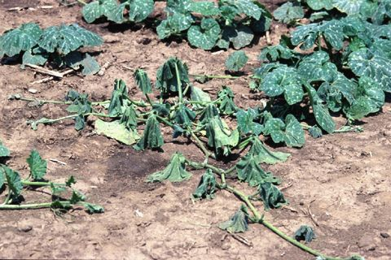
Phytophthora capsici (P. capsici) seedling and fruit blight

Slide 18
Phytophthora capsici (P. capsici) seedling and fruit blight
(Dr. Pingsheng Ji, UGA, Tifton)
Orondis (Oxithiapiprolin) or used as drip or foliar was effective against P. capsici

Slide 19
P. capsici (fungicide spray guide)
Orondis+Ridomil gold (applied as pre-plant or through drip)
Rotate with Presidio and Revus
Drip application: 2 applications of Orondis Gold in a 30 day interval after first application at planting.

Slide 20
Integrated Disease Management of
P. capsici
Rotate with non-host crops
Avoid poorly drained fields/areas in a field
Heavy rain at harvest difficult
Fungicides must be applied before disease onset
Presidio, Revus, Orondis

Slide 21
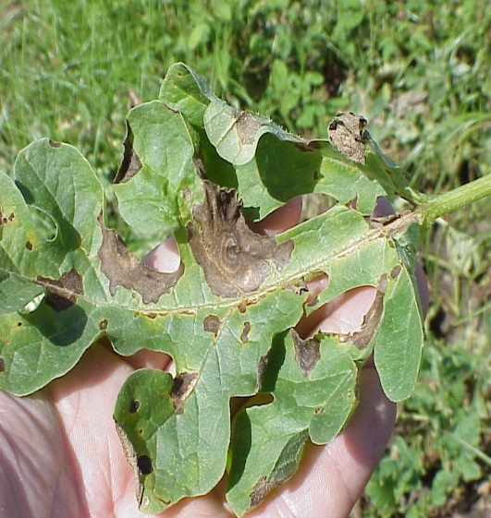
Management of Gummy stem blight in cucurbits
Spray Chlorothalonil Products
Cucumbers and squash season long
Rotation partners
Folicur + Generics (Tebuconazole)
Inspire Super (Difenoconazole + Cyprodinil)
Proline (Prothioconazole)
Switch (Fludioxonil + Cyprodinil)
Aprovia Top (Solatenol + Difenoconazole)
Luna Experience (Floupyram + Tebuconazole)

Slide 22
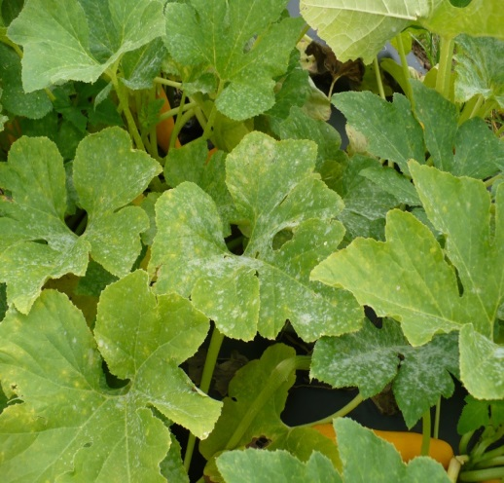
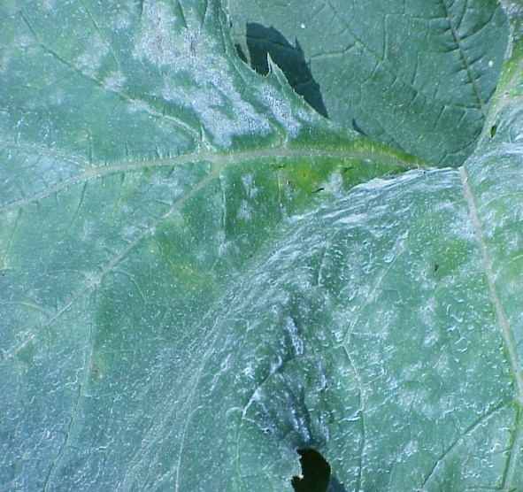
Powdery mildew trial in squash (2015)
Late season warm weather pathogen
Favors dry conditions
Rotate Torino, Proline /Procure for Squash
Quintec only labeled on Watermelon and Cantaloupe

Slide 23
Powdery mildew trial in squash (2015)

Slide 24
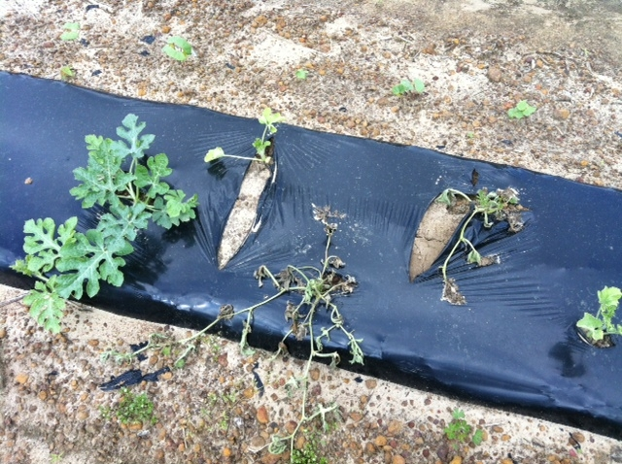
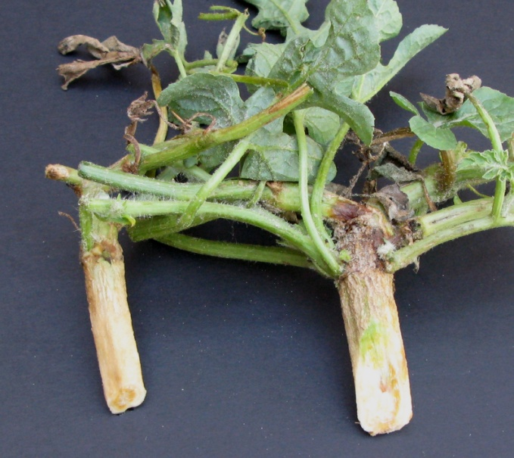
Fusarium wilt: Fusarium oxysporum f. sp. niveum
Damping-off, seedling disease, or wilt
First noticeable symptom: one side of a plant wilts
White, healthy roots, but the vascular tissue is brown and discolored
Infected plants appear in clusters

Slide 25
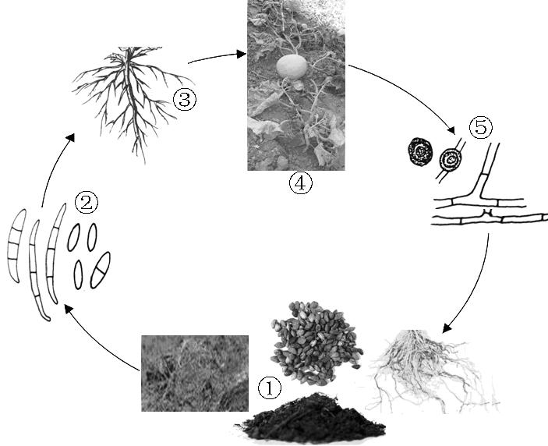
Disease Cycle
Infection occurs directly or through wounds
Fungus penetrates root hairs and blocks the vascular bundles
Formation of resting spores chlamydospores
Fungus survives in soil debris or on soil surface

Slide 26
Management of FON
Resistant watermelon cultivars
Crop rotation (5 years between watermelon)
Disease-free transplants
Seed certification for Fusarium
At-plant drench with Proline
Wikipedia .org

Slide 27
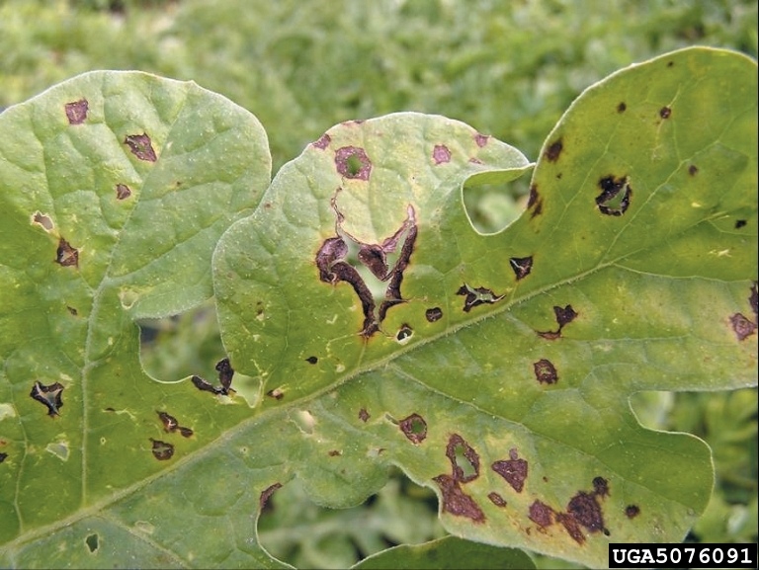
Anthracnose: Colletotrichum orbiculare
The fungus overwinters on diseased residue from the previous vine crop or volunteer
The pathogen may also be carried on cucurbit seed
In the spring under wet conditions the fungus releases airborne spores (conidia) that infect vines and foliage
The fungus depends on wetness and fairly high temperatures, 75°F (24°C) being considered optimum

Slide 28
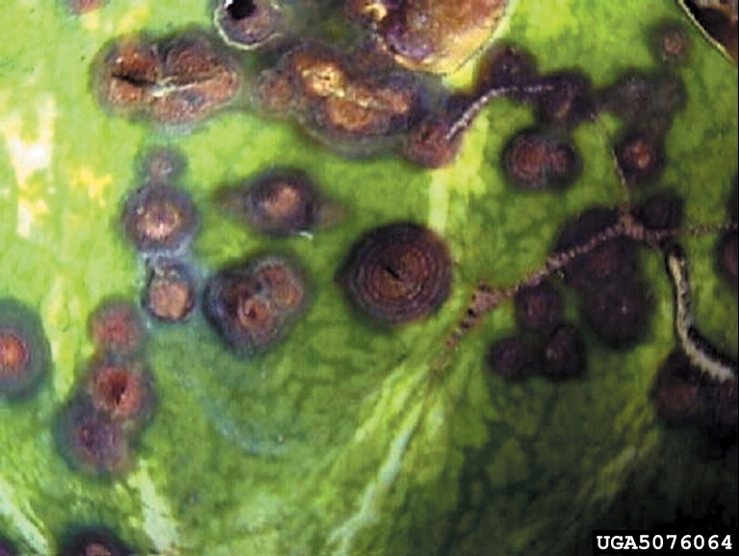
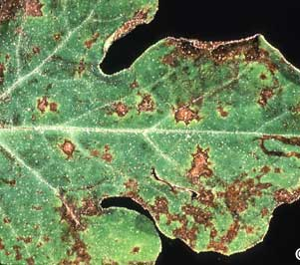
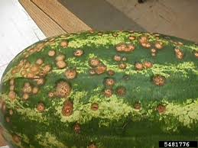
Anthracnose: symptoms

Slide 29
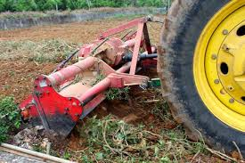
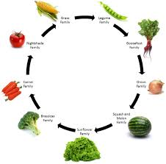
Management of anthracnose
Use disease-free seed
Rotate with non-cucurbit crops in a three-year rotation
Practice good sanitation by plowing under fruits and vines at the end of the season
Strobilurins (Quadris and Cabrio) are effective

Slide 30
Management of anthracnose
Choose anthracnose-resistant varieties if at all possible.
Resistant cucumber slicers include Dasher II, Slicemaster, and Poinsett 76
Many pickling cucumbers are tolerant or resistant, including Score and Premier
Resistant watermelon varieties include Charleston Gray, All Sweet, Crimson Sweet, and Dixielee
No anthracnose-resistant muskmelon varieties are currently available for the southeast

Slide 31
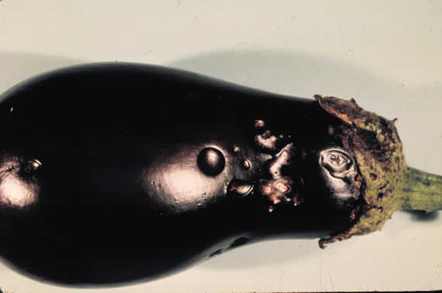
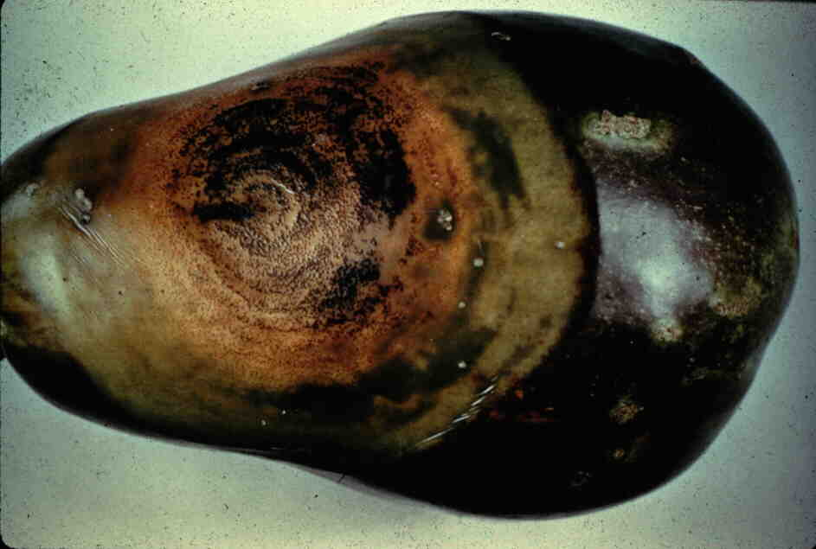
Phomopsis blight of eggplant
Rotate away from eggplant 3-4 years
Transplants should be Phomopsis free
Can survive on plant debris,
solanaceous weeds and also be
seedborne
Spreads by rain splashing

Slide 32
Phomopsis blight trial in egg plant (2015)

Slide 33
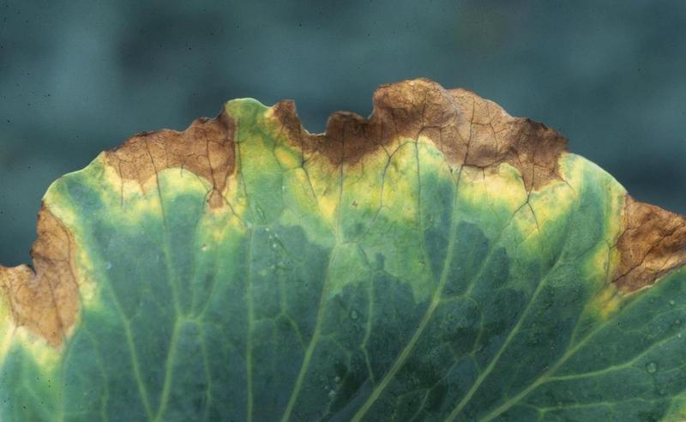
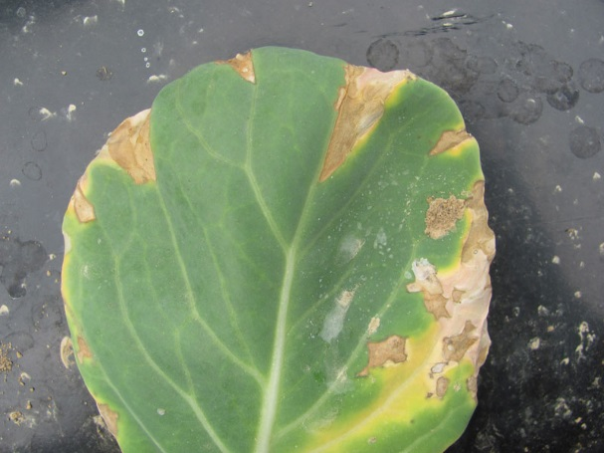
Black rot of leafy greens
Causal organism: Xanthomonas campestris pv. campestris
Most economically important disease in crucifers in GA
Sources of inoculum: seed, cruciferous weeds
Chemical management: Preventative spray of copper+mancozeb
Copper tolerance reported

Slide 34
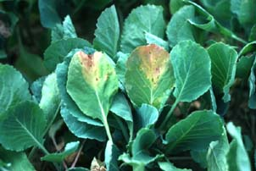
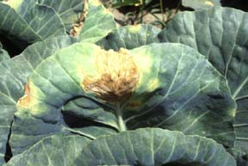
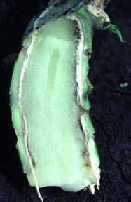
Symptoms of Black rot in cabbage
V-shaped lesion on
cabbage transplant
V-shaped lesion on cabbage
Discolored vascular tissue in cabbage stem and petiole

Slide 35
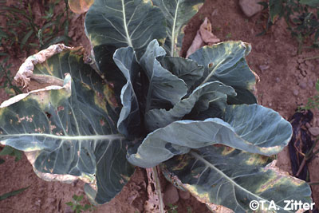
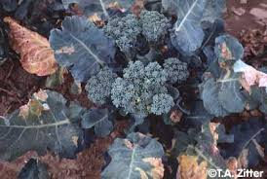
Symptoms of Black rot on other cruciferous hosts
Cauliflower
Broccoli
Other hosts: kale, Brussels sprout, radish, mustard, Chinese cabbage, watercress, arugula, rutabaga

Slide 36
Management Practices against Black Rot
Use black rot-tested, disease-free seed grown in an arid production area.
Seed treatment:
Hot water (50 degrees C for 25 minutes): cabbage, broccoli, and Brussels
Hot water (50 degrees C for 15 minutes): cauliflower, kale, turnip, and rutabaga
Chemical treatment: sodium hypochlorite, hydrogen peroxide, and hot acidified cupric acetate or zinc sulfate can be applied to eliminate the bacteria from crucifer plant seeds
Use certified disease-free transplants
Practice crop rotation where crucifers are grown only every 3 to 4 years to eliminate the inoculum sources from diseased crop debris in the soil

Slide 37
Management Practices against Black Rot
Good sanitation practices should be performed to prevent disease spread
Eliminate all volunteer crucifer plants from previous crops and alternative wild host plants within and around the field
Do not apply manure that may contain crucifer residues
Do not use sprinkler irrigation
Avoid working in the field when plants are wet
Do not allow machinery and equipment movement from infested areas to non-infested fields
Deep plow to bury all crucifer residues after harvest

Slide 38
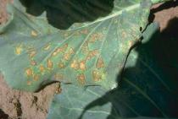
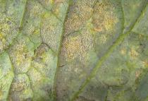
Sporulation underside of a leaf
Downy mildew of cabbage
(Peronospora parasitica)
Yellow spots on leaves which turn necrotic gradually

Slide 39
Downy mildew trial at UGA, Tifton (2015-16)

Slide 40
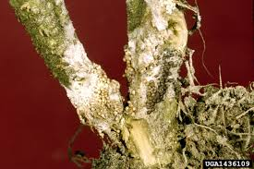
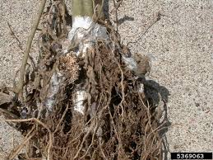
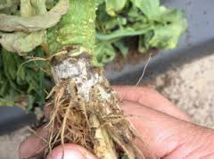
Southern blight: Sclerotium rolfsi

Slide 41
Southern blight trial at UGA, Tifton (2015)
Fontelis is the key in chemical management of southern blight
Fracture can be a rotation partner to reduce resistance problem

Slide 42
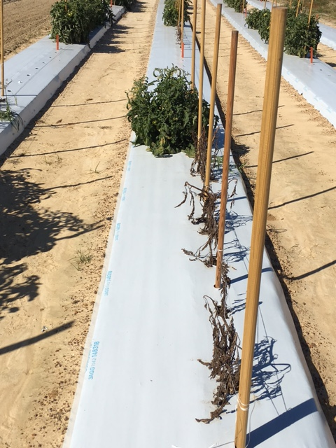
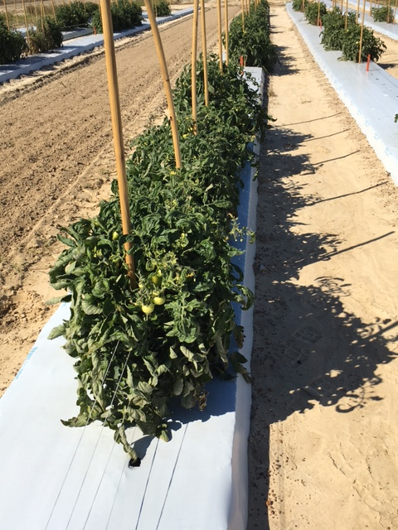
CONTROL
FONTELIS

Slide 43
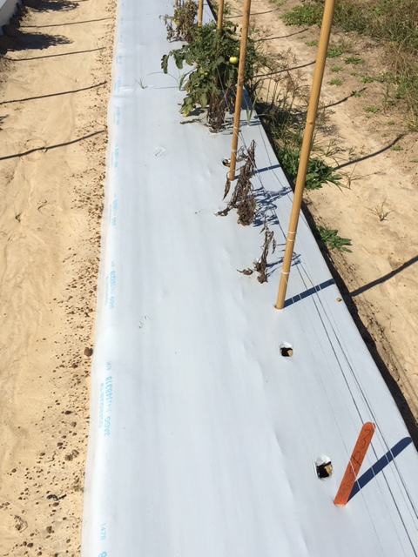
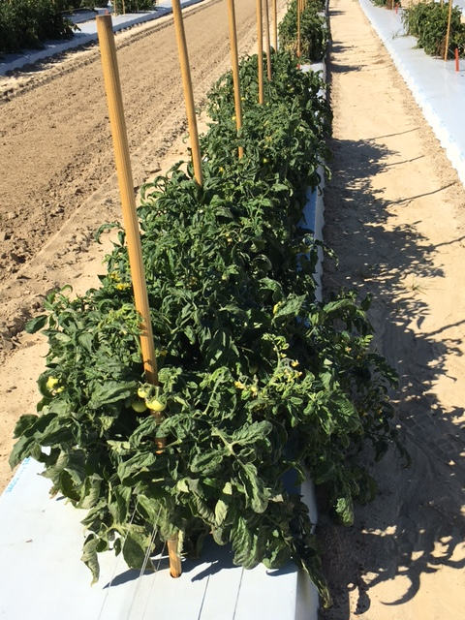
CONTROL
FONTELIS+FRACTURE

Slide 44
Bacterial spot in tomato trial at UGA, Tifton (2015)

Slide 45
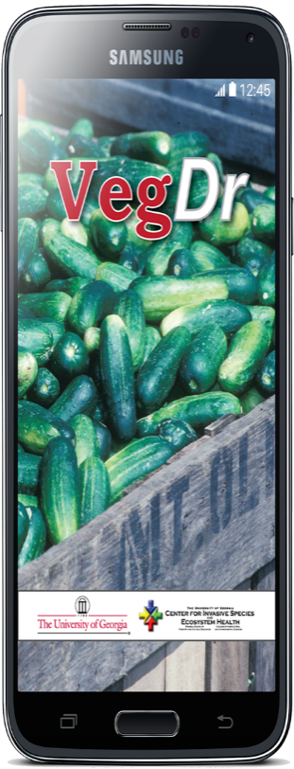
VegDr: New online resource for the vegetable grower
VegDr provides you with up-to-date information for vegetable diseases in Georgia
Cucumber, watermelon, squash, cantaloupe, pumpkin, tomato and pepper

